Slide 1
Reading Meeting Quiz 5

Slide 2
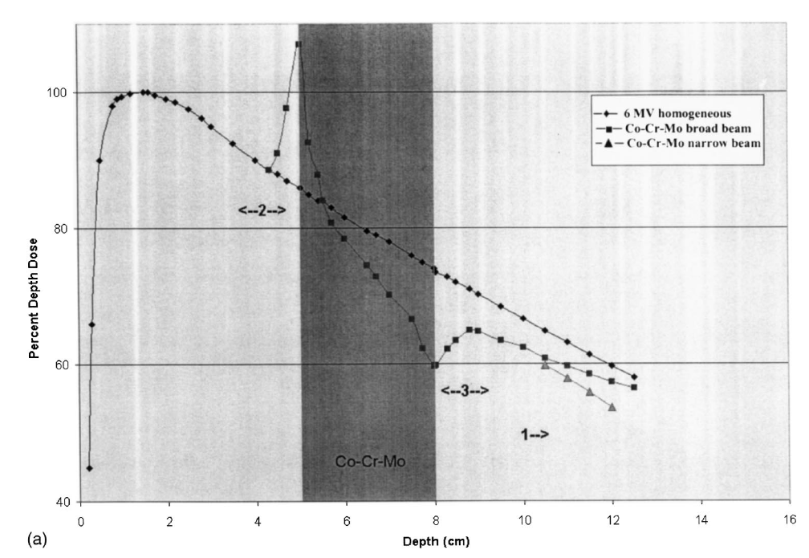
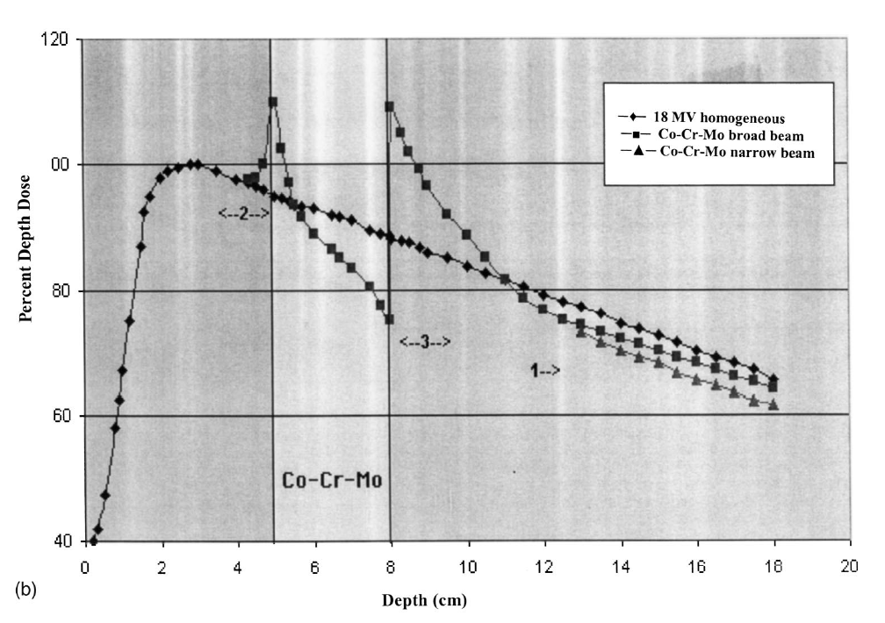
Q1
Explain the difference between (a) and (b)
What interactions are the reason for the PDD differences
What is Co-Cr-Mo commonly used for?
What document would provide further information on this?

Slide 3
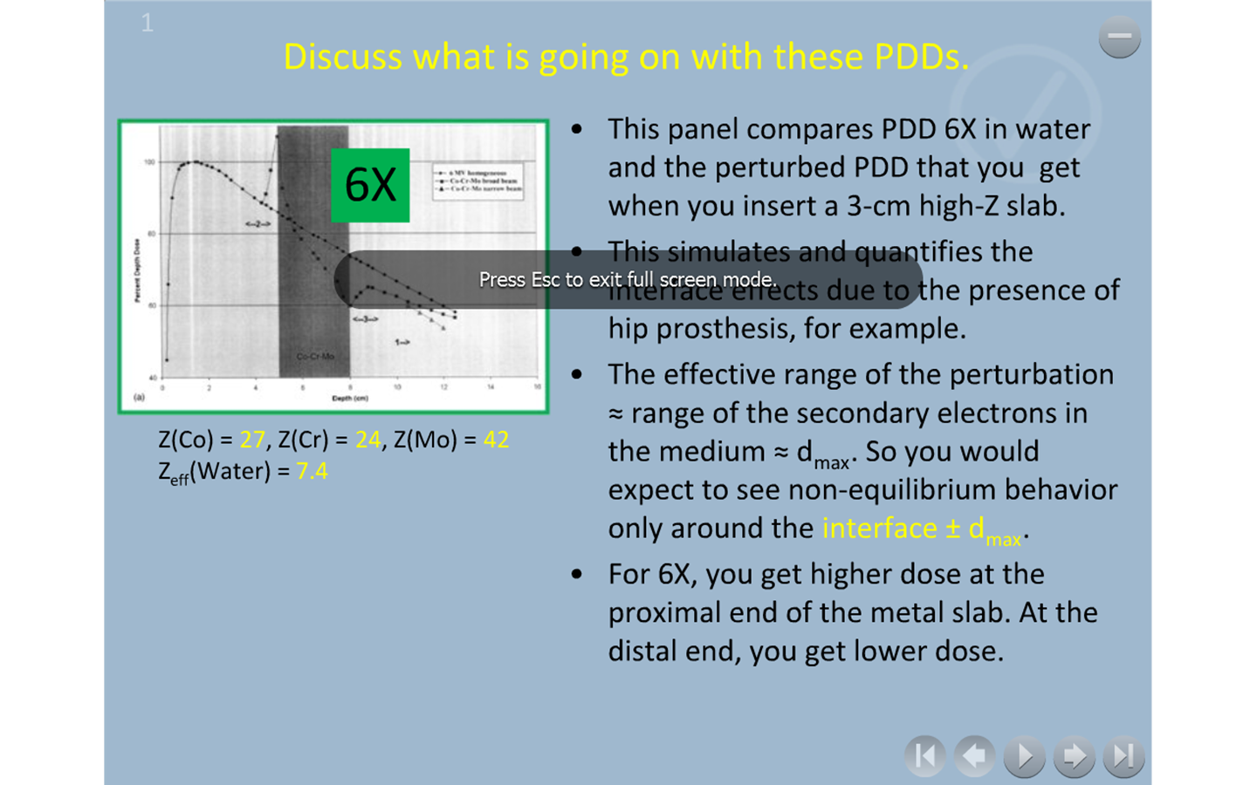

Slide 4
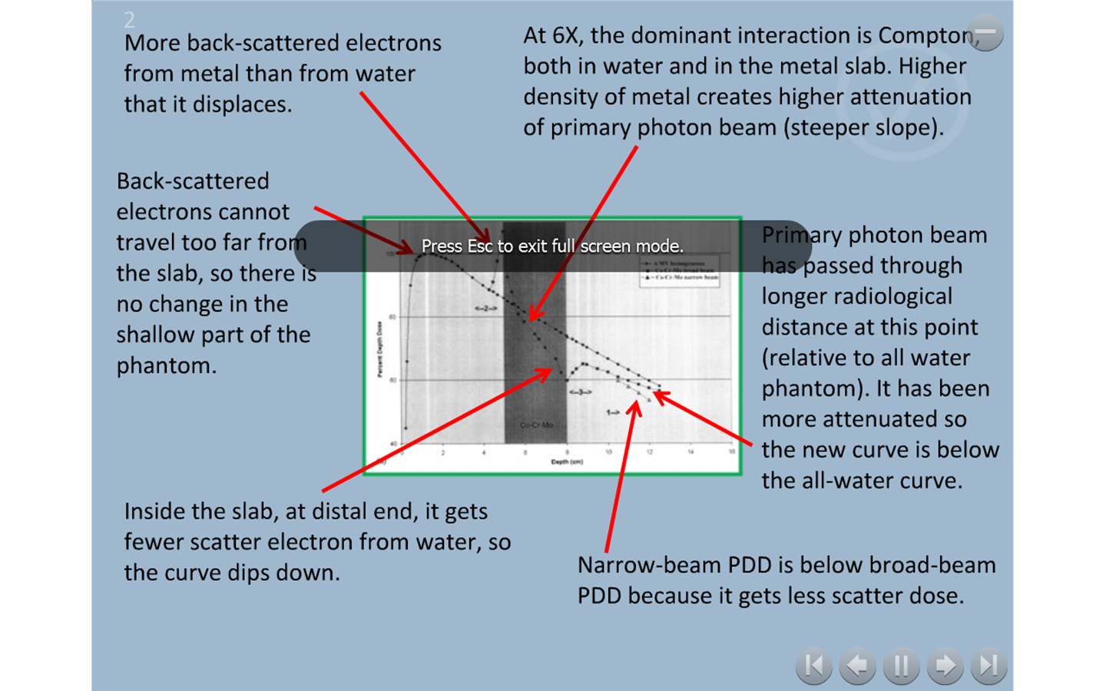

Slide 5
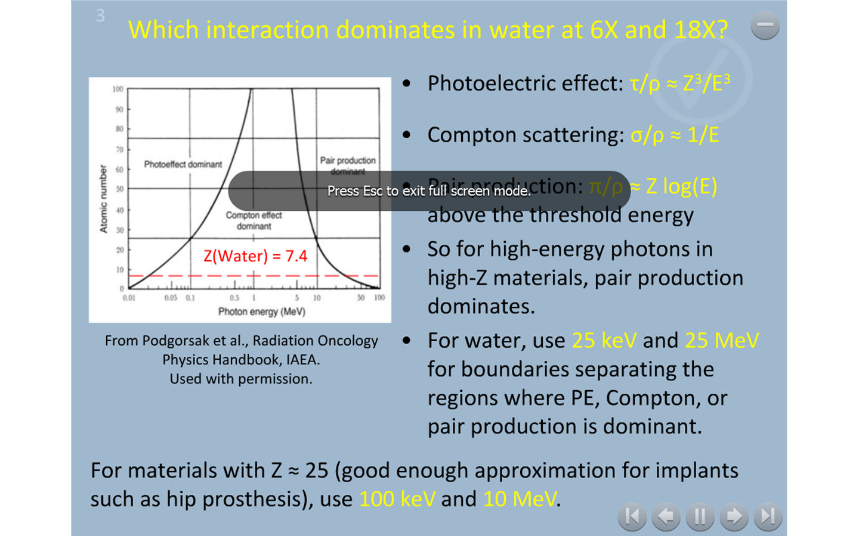

Slide 6
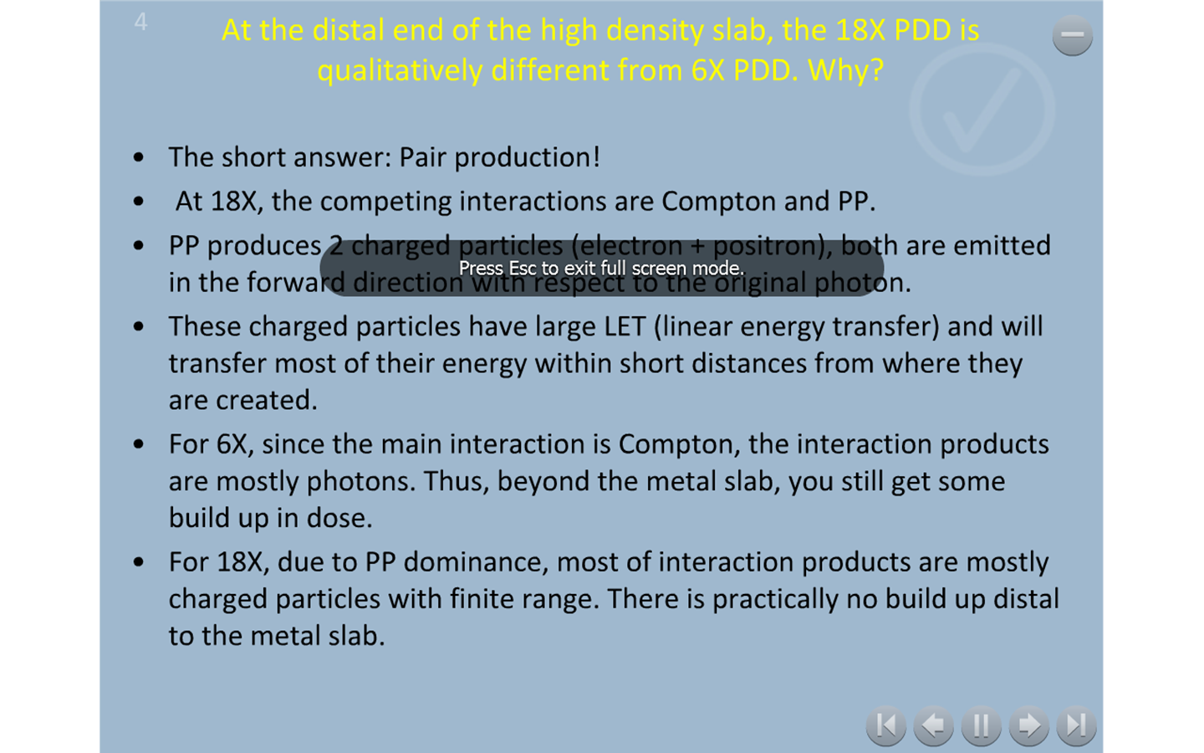

Slide 7
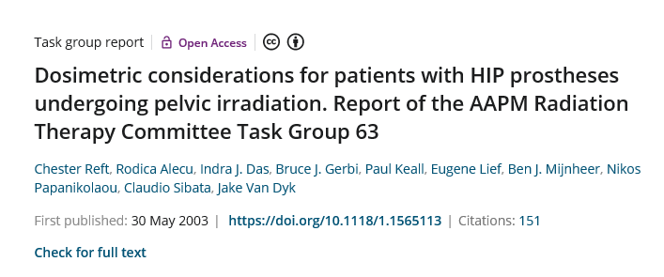

Slide 8

Q2
What correction method is shown here?
What category does this correction method fall under and what are the major limitations of this category?
What document provides more information on this and other methods?

Slide 9
Four categories (TG-65)
Categorization according to:
Ability to treat primary TERMA and electron transport separately
Whether anatomy is being sampled along 1-D primary rays or full 3D

Slide 10
1.4 Power law (Batho)
Empirical correction factor for points lying beyond a heterogeneity
Sensitive to the proximity of inhomogeneity
Provide first order approximation to changes in both primary and scattered photon fluencies

Slide 11
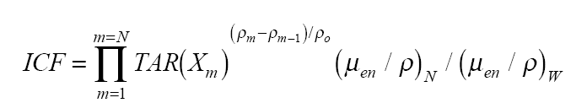
1.4 Power law (Batho)
Can be adapted for use with CT voxel data
Provides an acceptable approximation below a single inhomogeneous layer larger than the field size
Limited by requirement of lateral CPE
Dose error increases with higher energy of photon, smaller field size (due to neglect of electron transport)
Batho method under-corrects when the density is less than water density and over-corrects for greater density

Slide 12
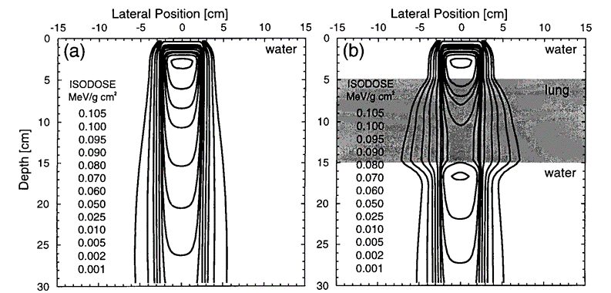
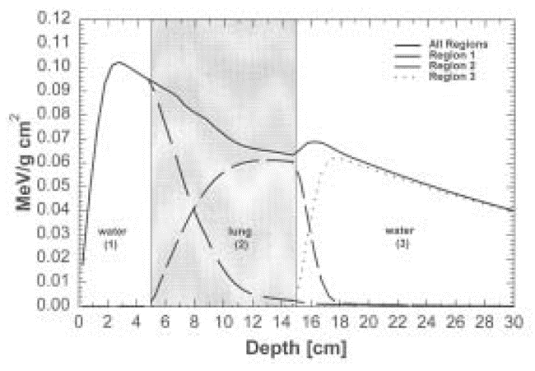
Q3
Explain the following figures. What treatment site would this relate to? Which category of correction method would be needed for calculations?

Slide 13
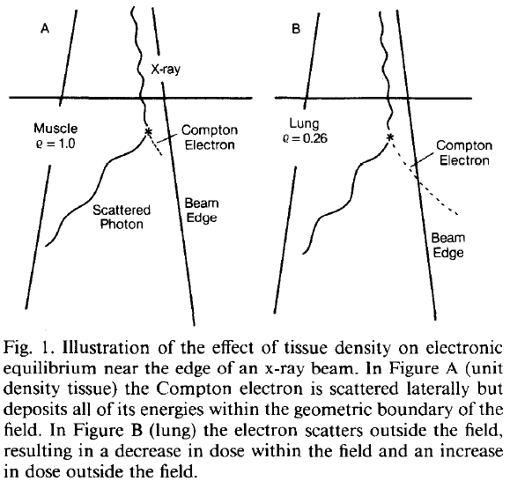
Illustration of tissue density effect near the beam edge
Increase in Penumbra, especially for high energy beam.
Notes:
The problem is caused by the increased range of secondary electrons produced mainly by Compton interactions of the photons with the
medium. Since the electrons scatter laterally in addition to moving forward with the beam, an increased range causes a greater number of electrons to travel outside the geometric boundaries of the radiation field. Thus, the dose on the periphery of the beam decreases in comparison to that on the central axis, where electronic equilibrium is present.
This may result in an increase in penumbra and a deterioration in the flatness of the beam.
In lung tissue, where the electron range is much greater than in normal-density tissue, the problems of increased
penumbra and loss of flatness are even greater.

Slide 14
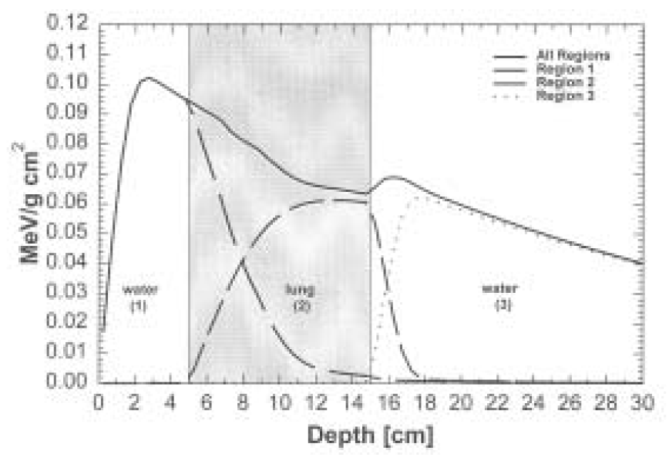
Density Effects
Initial “build-up” of dose in water
“Build-down” of dose in air
“Re-build-up” of dose in distal water
Contributions of electron contributions launched in different density region

Slide 15
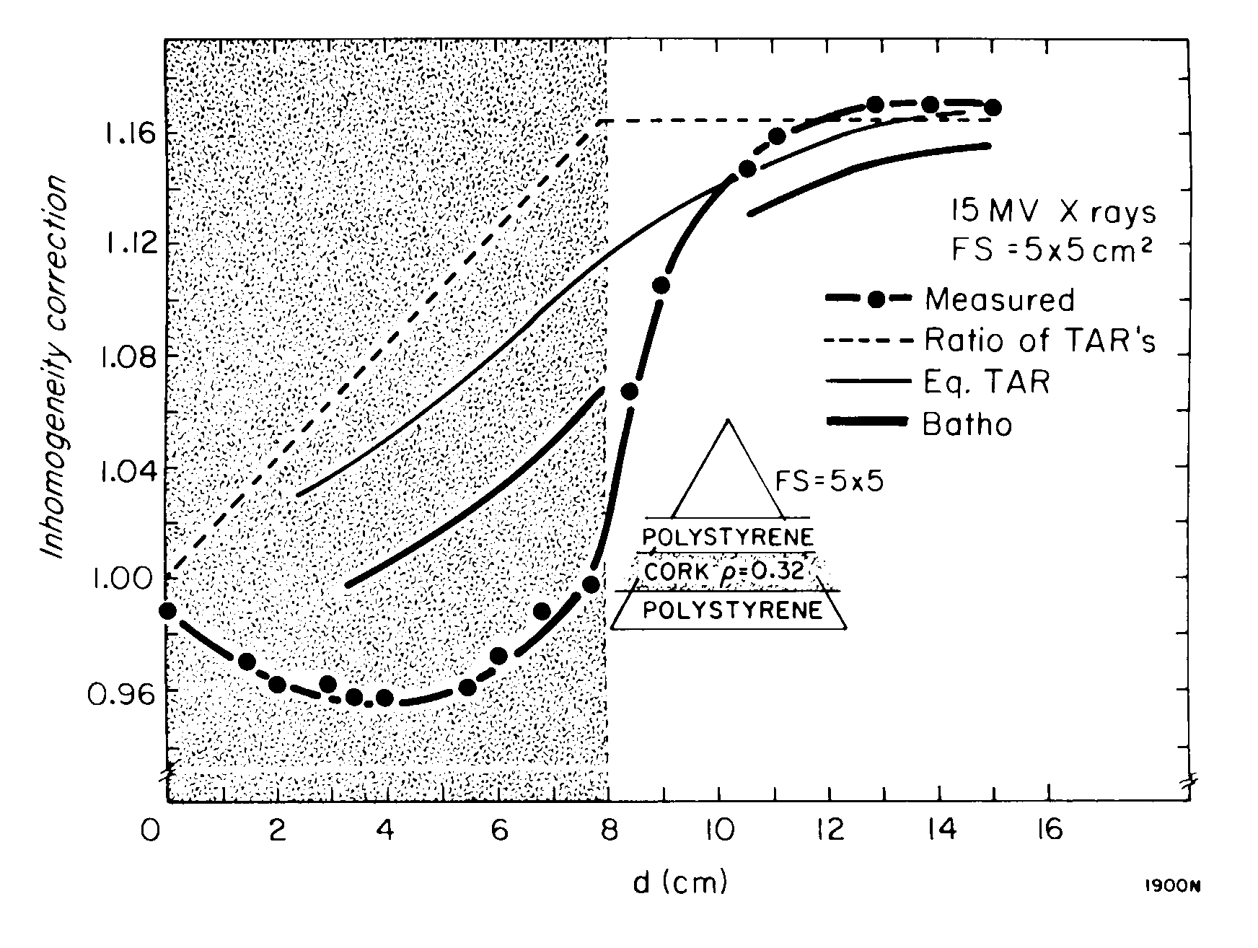
Lung Dose: Calculation vs Measurement
15MV,
5 x 5 cm²
Path-length based algorithms do NOT work in regions of electron disequilibrium.
At location farther away from the interface, the conventional algorithms are fairly correct.
Notes:
In this slide, I show the comparison between …

